Slide 1

Composer AI
Fazekas Gergő, Joseph Tadrous

Slide 2
Agenda
Goal
Concept
Ideas
Summary

Slide 3

Goal

Slide 4
Goal
Classical piano piece composer artificial intelligence
Steps
Learning one music piece
Quick feedback
Architect model
Setting hyperparameters
Learning universal patterns
Long training process
Improve music generation

Slide 5

Concept

Slide 6

Concept
Classical Music MIDI dataset
Note information
Pitches (multi-hot encoding) -> classification
Duration -> regression
Velocity -> regression
Model with multiple inputs and outputs
Generation
Start from random state
Output is in the next input

Slide 7

Ideas

Slide 8

Regression - only one note at the time
Inputs and outputs as numbers (regression)
Pitch
Duration
Step

Slide 9
Two models – one pitch at the time
Model
Inputs:
Prevoius pitches (one-hot encoding)
Output:
Pitch (one-hot encoding)
Model
Inputs
Previous pitches, durations and steps (as numbers)
Outputs:
Duration and step

Slide 10
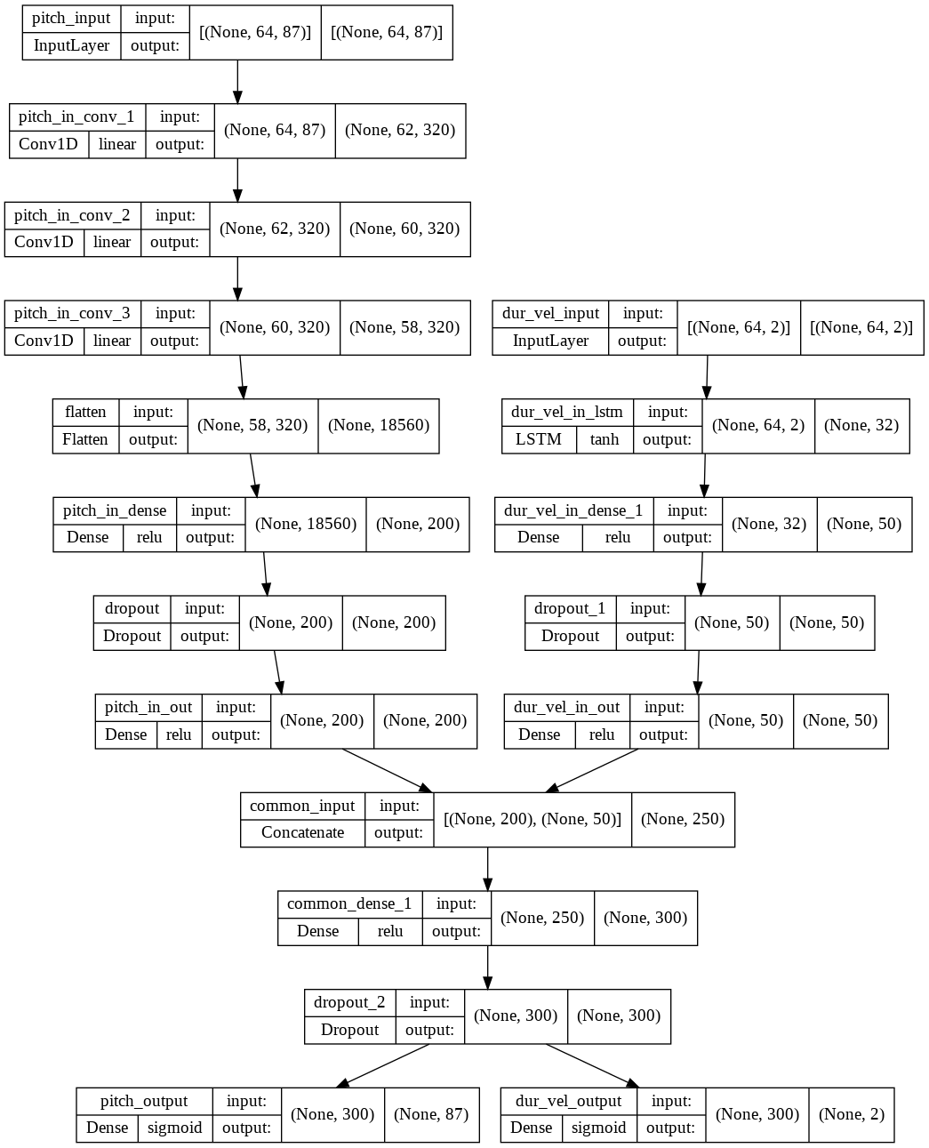
Complex model
Structure
Pitches input (multi-hot encoding): convolutional
Duration velocity input: LSTM
Common part
Pitches output: classification
Duration, velocity output: regression
Loss
1:0.2 ratio between pitches and duration, velocity
4,562,049 parameters

Slide 11
Complex model - Results
LSTM
Convolutional
Mozart (from random state)
Funfact: at least pitches at the time
From multiple pieces

Slide 12
Summary

Slide 13
Summary
We implemented many models
We managed to teach one song for the model
Finding universal patterns is challenging

Slide 14
Thank you for the attention!

